Slide 1
Create a RESTful API with ASP.Net Core and Swagger

Slide 2
Source code …
https://github.com/gdzierzon/ndc-minnesota-2019

Slide 3
What will we cover?
What is REST?
ASP.NET Core WebAPI
Swagger

Slide 4

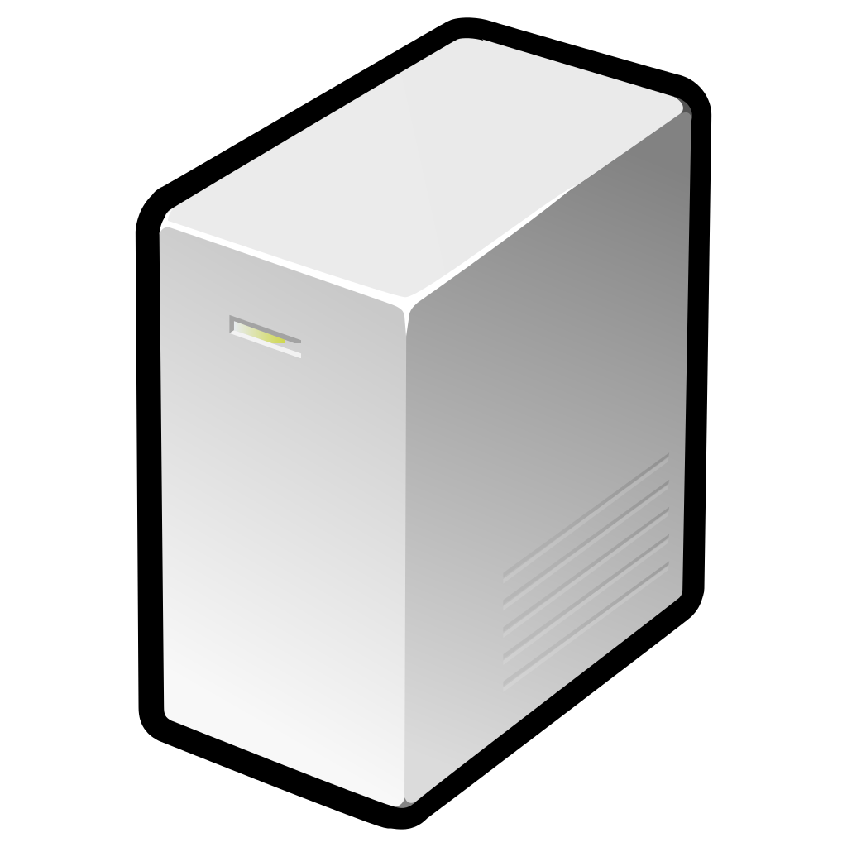
SOAP (.asmx Web Services)
.NET Remoting
WCF
REST
GraphQL

Slide 5
WCF vs REST vs GraphQL
WCF
REST
GraphQL
Business Logic
Heavy Documentation
Endpoints with many methods
Business Layer
Resource Driven
Little Documentation
Endpoint has few actions
Repository Layer
Resource and its Relationships
Semantic Model
Endpoint has few actions
Repository Layer

Slide 6
WCF vs REST vs GraphQL
WCF
REST
GraphQL
Server – Flexible
Client – Rigid
Server – Rigid
Client – Rigid
Server – Rigid
Client – Flexible

Slide 7
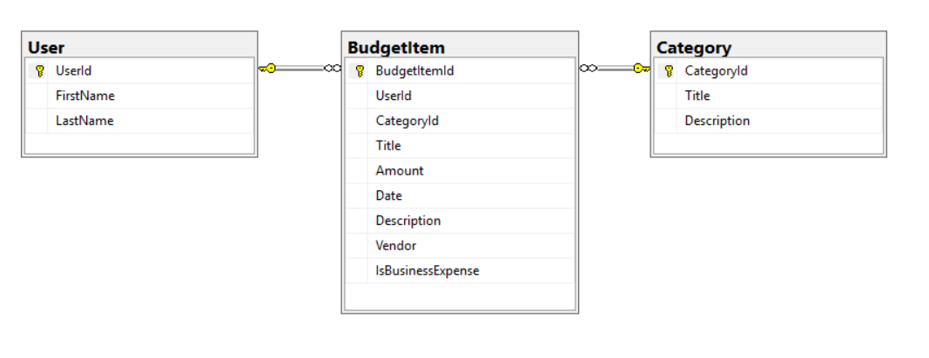
WCF vs REST vs GraphQL
WCF
REST
GraphQL

Slide 8
What issues does REST actually solve?

Slide 9
REST is a well defined
Architectural
Standard
Separation of Business Domain and Server Resources
Well defined verbs/actions
Focuses on the resource
Not business logic
Not relationships

Slide 10
WCF/SOAP Methods
GetAllUsers
GetUserById
GetUserAndBudgetByUserId
GetUserAndBydgetByCategory
InsertUser
UpdateUser
DeleteUser
…

Slide 11
REST Verbs
GET
GET
POST
PUT
DELETE
PATCH
OPTIONS
HEAD
TRACE

Slide 12
IDEMPOTENCE – what is it?
Idempotence means that you can execute an action over and over… and the effect on the resource will never change.

Slide 13
REST Verbs
GET – idempotent
POST – not idempotent
PUT – idempotent
DELETE – idempotent
PATCH – idempotent

Slide 14
ASP.NET Core WebAPI != REST
It’s just a framework (does not enforce REST)
Many (possibly most) WebAPI services that are created are not RESTful services
Treated more like WCF Services
REST is a mindset
Requires adoption (buy in) from client and server teams
REST is NOT the answer to all your problems!

Slide 15
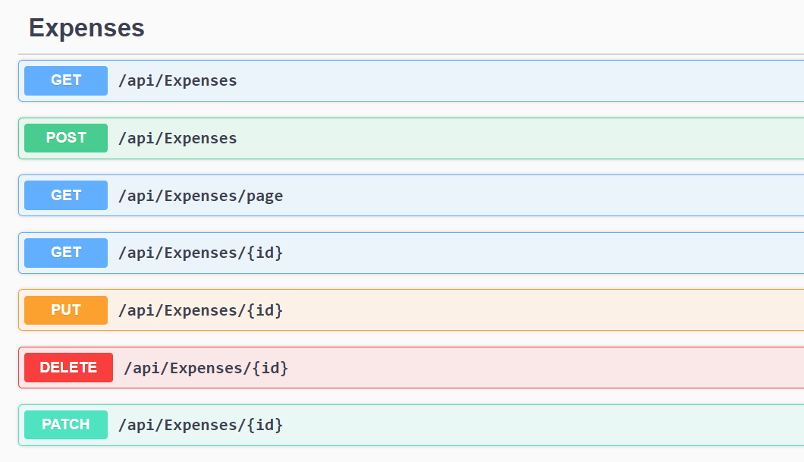
What about Swagger?

